Slide 1

EDA on Zomato data set
Coursera-Capstone Project

Slide 2
Introduction
Capital city of India i.e. New Delhi is having 11 districts with a total population of 257,803. However, the much larger metro area has a population that exceeds 26 million.
Terms Delhi and New Delhi are used interchangeably to refer to the National Capital Territory of Delhi (NCT), these are two distinct entities, with New Delhi forming a smaller part of Delhi.
The local language of New Delhi is Hindi. However, English is also spoken as a formal/official language in businesses private and government organizations.
Delhi population comprising of diverse culture has diverse food items in habits as well. There are many restaurants in New Delhi serving Chinese , Italian , French, Continental etc. So as a part of this project , I will list and visualise all major parts of New Delhi and will work on food supply data. People who wish to enquire about the food habits followed by Delhi people may get benefitted from this analysis.

Slide 3
Aims/Objectives
To know the following
Best location in New Delhi City for Chinese Cuisines
Areas having less number of restaurants
Best place to stay if I prefer going to restaurants frequently
Where exactly should I not look for any good restaurant

Slide 4
Data Sources
New Delhi Restaurants data that contains list Locality, Restaurant name,Rating along with their latitude and longitude.
Data source : Zomato kaggel dataset
Description : This data set contains the required information. And we will use this data set to explore various locality of new delhi city.
Nearby places in each locality of new delhi city.
Data source : Fousquare API

Slide 5
Approach towards analysis
Collect the new delhi city data from Zomato kaggel dataset
Using FourSquare API we will find all venues for each neighborhood.
Filter out all venues that are nearby by locality.
Using aggregative rating for each resturant to find the best places.
Visualize the Ranking of neighborhoods using folium library(python

Slide 6
Results Obtained

Slide 7
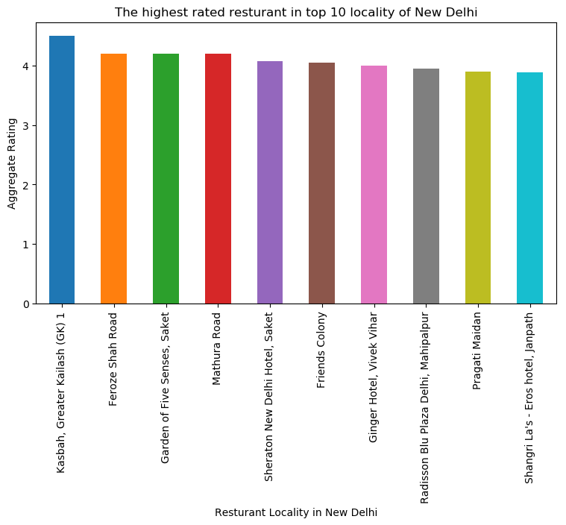

Slide 8
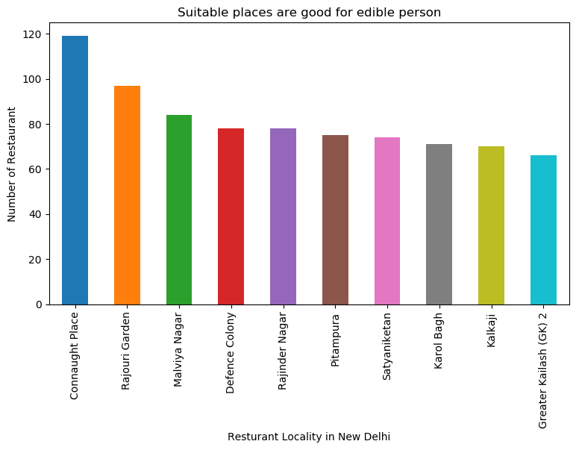

Slide 9
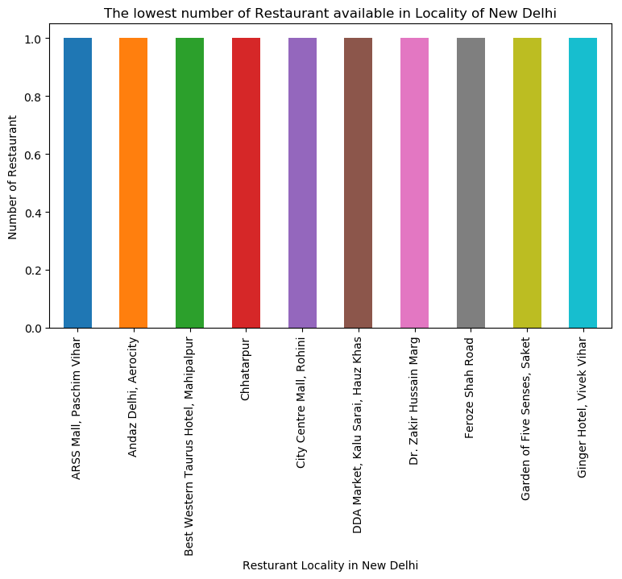

Slide 10
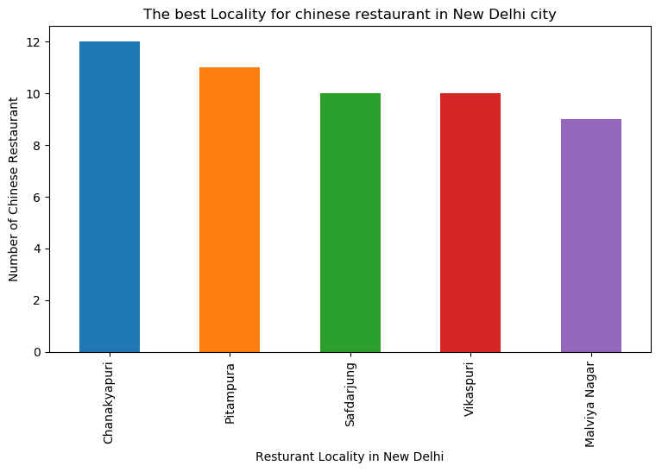

Slide 11
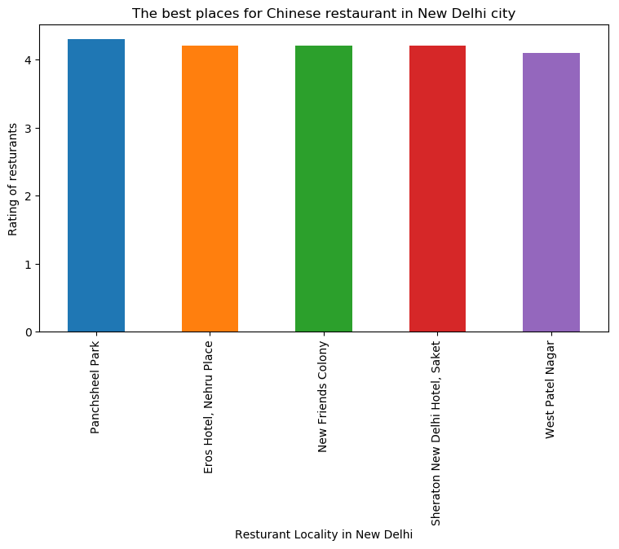

Slide 12


